Slide 1
CAR 163916513 Observation
Presented by Thomas Kestner

Slide 2
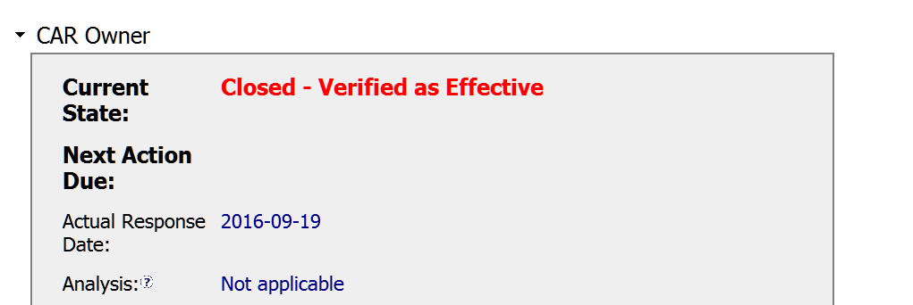
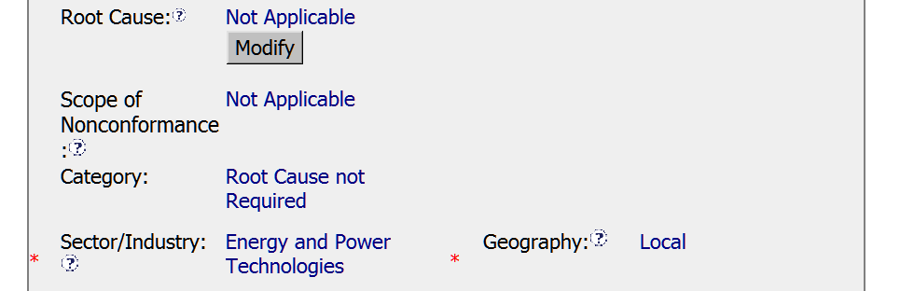
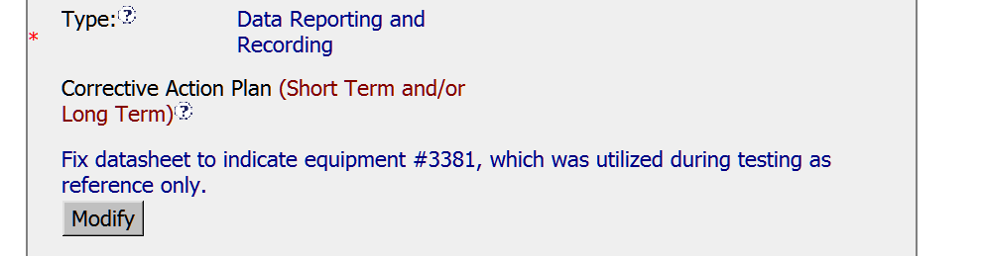
Correct Choice for Observation CAR before 2016-10-1.
Correct Choice for Observation CAR. before 21016-10-1

Slide 3
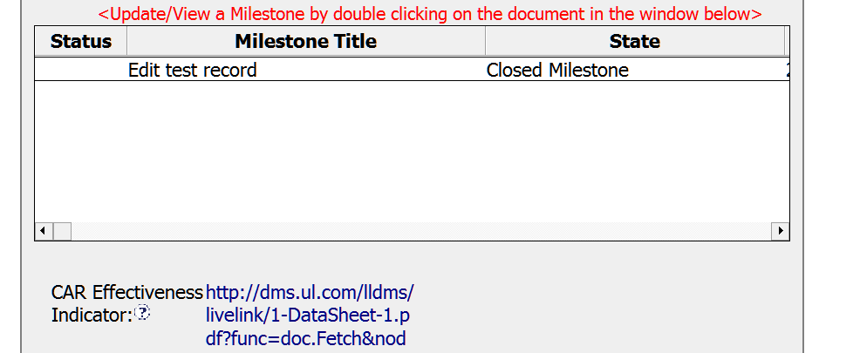
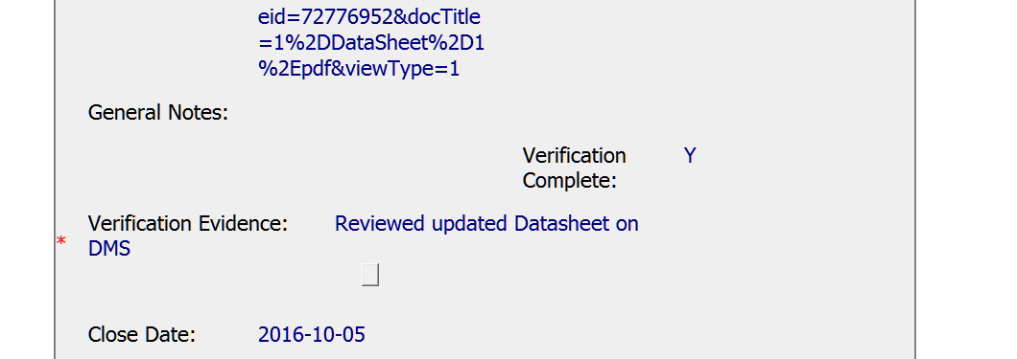
Verification completed right after CAR was closed.

Slide 4
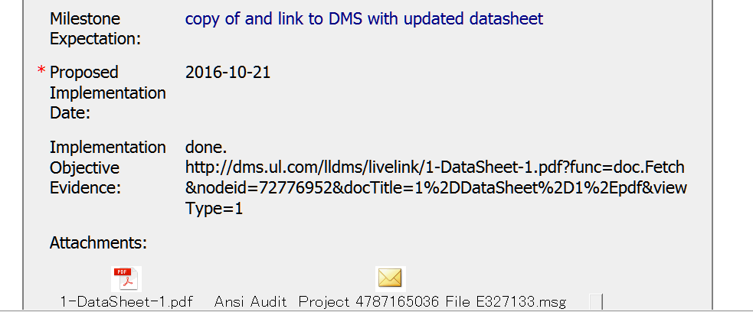

Good expectation
Datasheet does not state Reference Only
Milestone:
DMS:
However datasheet in DMS under Test Record Supplement is corrected

Slide 5
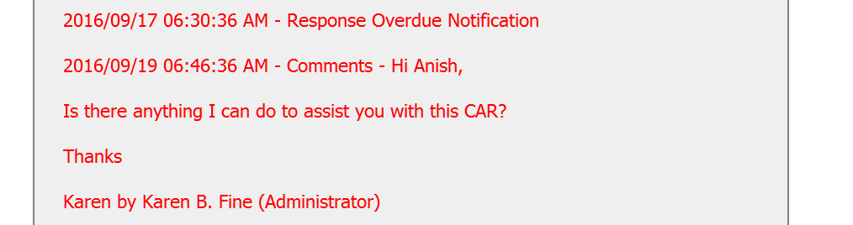
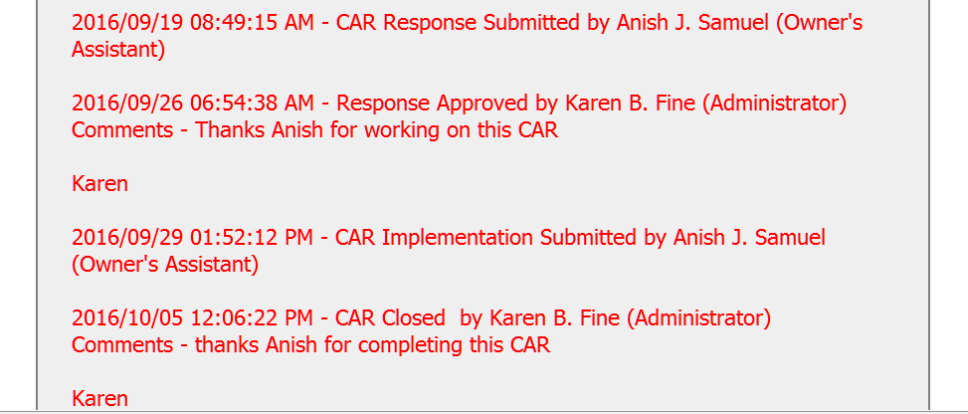
CAR Champion offered help soon after overdue.
Thank you note from CAR Champion
Thank you note from CAR Champion

Slide 6
Objective evidence in the milestone is not accurate, but the one in DMS is correct.

